Slide 1
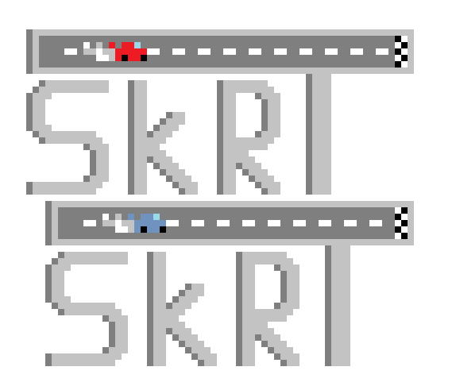
Pooya, Kyle, Sean, Davis

Slide 2
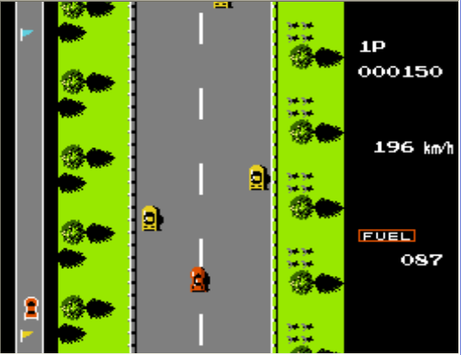
Inspiration
Our original game plan was heavily inspired by a video game called Road Fighter. Road Fighter was released in 1984 by Konami.

Slide 3
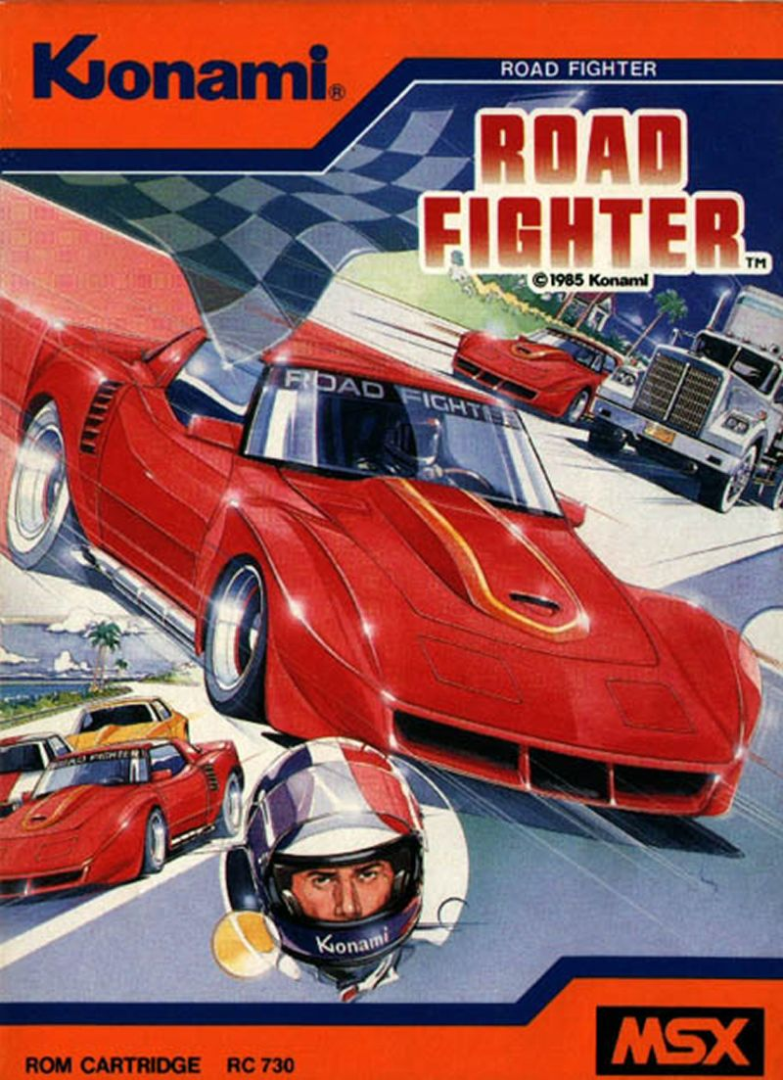
Division of Labor
Pooya: Ideas and programming
Kyle: Programming
Sean: Graphics
Davis: Ideas

Slide 4
Challenges
Collision
Spawning traffic
Background movement
Title Screen

Slide 5
With more time...
Completing collisions
Car Ai
Proper utilization of fuel mechanics
Obstacles

